Slide 1
Let’s talk about Conversation Design
BRK3301
Vishwac Sena Kannan
Senior Program Manager
vkannan@microsoft.com

Slide 2






What is a Bot?
TYPE
TAP
TALK
Channels
Cortana
Facebook Messenger
Custom – Direct Line
Skype
Connected Services
Intelligent tools
Bing

Slide 3

What is a Bot?
Platform
Platform
services
HTTP
AI
{ Your Code }
REST Endpoint
SDK
Intelligent tools
Bot builder SDK
REST Endpoint
Direct Line Protocol
Conversational and Business Logic
Canvas Aware
Context
Sensitive

Slide 4
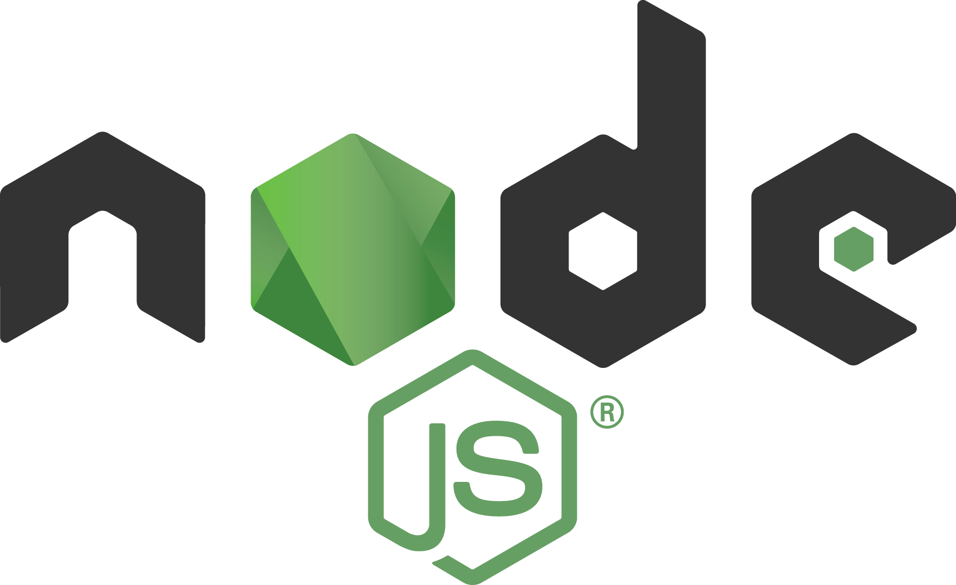


What is the Bot Framework?
What?
Channels – 1’st and 3’rd party
Hosting services – Azure Bot Service, Conversation Designer
Tools – Emulators, Webchat, Client controls, SDK’s, Analytics
Customer’s
business logic and data
Bot Connector
Why?
Implements standard protocols
Modeling conversations is hard. Tools help!
UI across multiple canvases is hard. Cards rock!
Language understanding is hard
Common and well understood patterns
C#
BOT BUILDER
Bot Controls
Goals
Start simple. Add complexity. No dead-ends
Bot adapts to the user, based on context
Composable and intelligent controls to manage complexity
Skype
Bing
Web Chat
LUIS
Form filling
Q&A
LUIS
Skype for Business
Cortana
Direct Line
Query over database
via Azure Search
Third-Party

Slide 5
Demo

Slide 6
What makes a bot great?
Not how much AI it has
Not how sophisticated the language model is
Not whether it uses voice or not
Not whether it uses Buttons/Cards

Slide 7
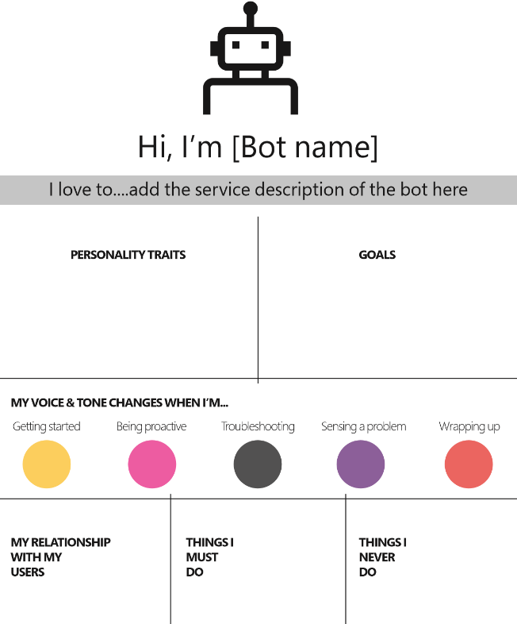
Great bots are like great apps; they appeal to users because they do whatever they're trying to do WELL

Slide 8
Building conversational experiences
LU
DIA
LG
UX
<>
Language understanding:
Utterance →
[domain X intent X slots]
Dialogue:
Conversational flow/ model between bot and user
Language generation:
Spoken, display strings
for the agent
User Experience
Cards on-screen or speech-out for given turn in a conversation
Business logic
Business rules that help direct conversational flow
SR
TTS
Speech Recognition
Speech → Utterance
Text to speech:
Utterance → Speech

Slide 9





Cognitive services
LU
DIA
LG
UX
<>
Language understanding:
Utterance →
[domain X intent X slots]
Dialogue:
Conversational flow/ model between bot and user
Language generation:
Spoken, display strings
for the agent
User Experience
Cards on-screen or speech-out for given turn in a conversation
Business logic
Business rules that help direct conversational flow
SR
TTS
Speech Recognition
Speech → Utterance
Text to speech:
Utterance → Speech
Cognitive Services
Vision
Speech
Language
Knowledge
Search

Slide 10








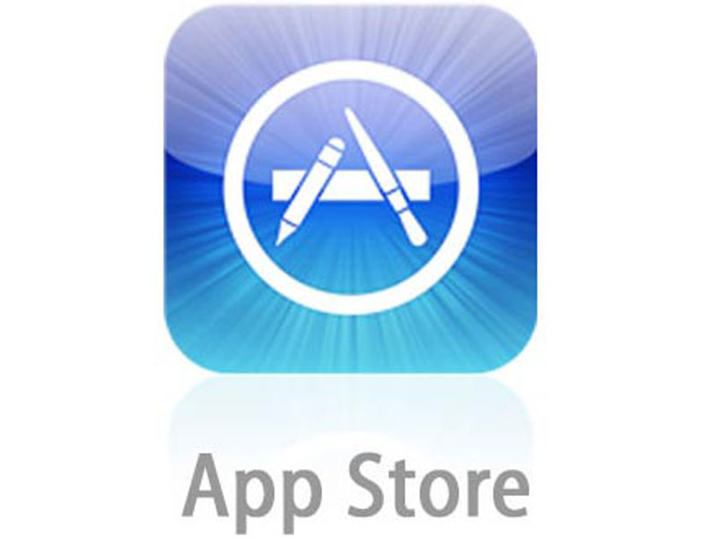
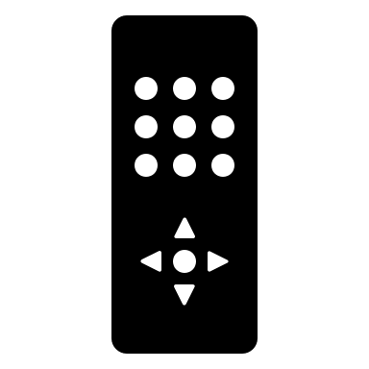
















Ubiquitous conversations
  Custom app or website
Custom devices
1st and 3rd Party Channels

Slide 11

Designing for Bot’s Input/ Output
TYPE
TAP
TALK
User
TYPE
CARD
TALK
Bot
  Custom app or website
Custom devices
1st and 3rd Party Channels

Slide 12
Type, Tap & Talk – where & why
Type
Tap
Talk
Great for communication apps
User is already typing in these experiences
Supplement conversational experiences in custom apps/ website
On PC/ mobile form factors
Users are accustomed to click/ tap experience
IoT/ speech-first device form factor and experience
Assistant experiences like Cortana

Slide 13
Demo
ContosoCafeOnTheWeb, different channels

Slide 14
Modelling conversations - Types of dialogue
Single turn conversation
Structured directed flows
Context carry-over
Modelled like simple question and answer pairs
Typically there are no follow up questions from the user
No bot-initiated questions either
E.g. Q&A, Facts, Answers
Requires collecting pieces of missing information required for task completion
On-the-rails conversation.
Multi-turn capable; but can be single-turn
Can include business logic to direct conversational flow
E.g. Ticket booking, form filling, Order stuff
Open ended conversation in a specific domain or intent
Multi-turn capable
Context (domain, intent, entities) carried forward across conversation
E.g. Search refinement

Slide 15
Demo
ContosoCafeOnTheWeb

Slide 16
Qnamaker.ai
One of the Microsoft Cognitive Services
Build, train and publish a simple question and answer bot based on FAQ URLs, structured documents or editorial content in minutes.
Offers a no-code experience to build single-turn conversations
Supports a variety of content sources you could start from –
  Existing FAQ pages
  Import question and answer pairs from .tsv, .pdf, .doc, .docx, .xlsx
  Friendly user interface to enter question and answer pairs in the knowledge base table

Slide 17
Demo
Qnamaker.ai

Slide 18
Conversational experiences
The Good
The Challenge
Easier and more natural
Traversals, less steps (e.g. dinner reservation)
Devices with limited or no display surface/ typing is not an option or is cumbersome (e.g. Xbox, Invoke)
Multitasking (e.g. control music while writing a doc)
Setting up language understanding to allow for conversational tangents, corrections, forward-slot filling
Deciding the right conversation model for your scenario
Environment (e.g. speech in a noisy environment)
Adapting to context – device as well as user

Slide 19
Conversation Designer

Slide 20
Conversation Designer
What are we building?
One stop shop development experience
Seamlessly brings together several aspects
of bot development—LU, LG, UX, Dialogue
Visual authoring experience to
build conversational bots
Clear separation between conversation
logic vs. business logic
Conversation runtime orchestrate bot conversations
https://microsoft.sharepoint.com/teams/BrandCentral/Pages/Bundles/MSC16_slalom_056.aspx

Slide 21

Conversation Designer
Why are we building it?
Building bots is a multi-role collaborative effort
Learnings from Bot Framework community as
well as first-party Bot development (Cortana)
Visual tool to help author E2E Natural Language conversations that users can type, tap or talk to
Modelling conversations in code
behind can be challenging
https://microsoft.sharepoint.com/teams/BrandCentral/Pages/Bundles/MSC16_slalom_056.aspx

Slide 22
Conversation Designer
Covers all aspects of bot development
Conversation Designer
LUIS integration
Script trigger
Simple reply
Script action
Dialogue action
Simple and conditional response template
Speak vs. display
Cards, designer and preview
JavaScript code
HTTP wrapper
Azure Functions
LU
DIA
LG
UX
<>
Language understanding:
Utterance →
[domain X intent X slots]
Dialogue:
Conversational flow between agent and user including logic that directs flow
Language generation:
Spoken, display strings
for the agent
Cards on-screen or speech-out for given turn in a conversation
Bot’s business
logic/code behind

Slide 23

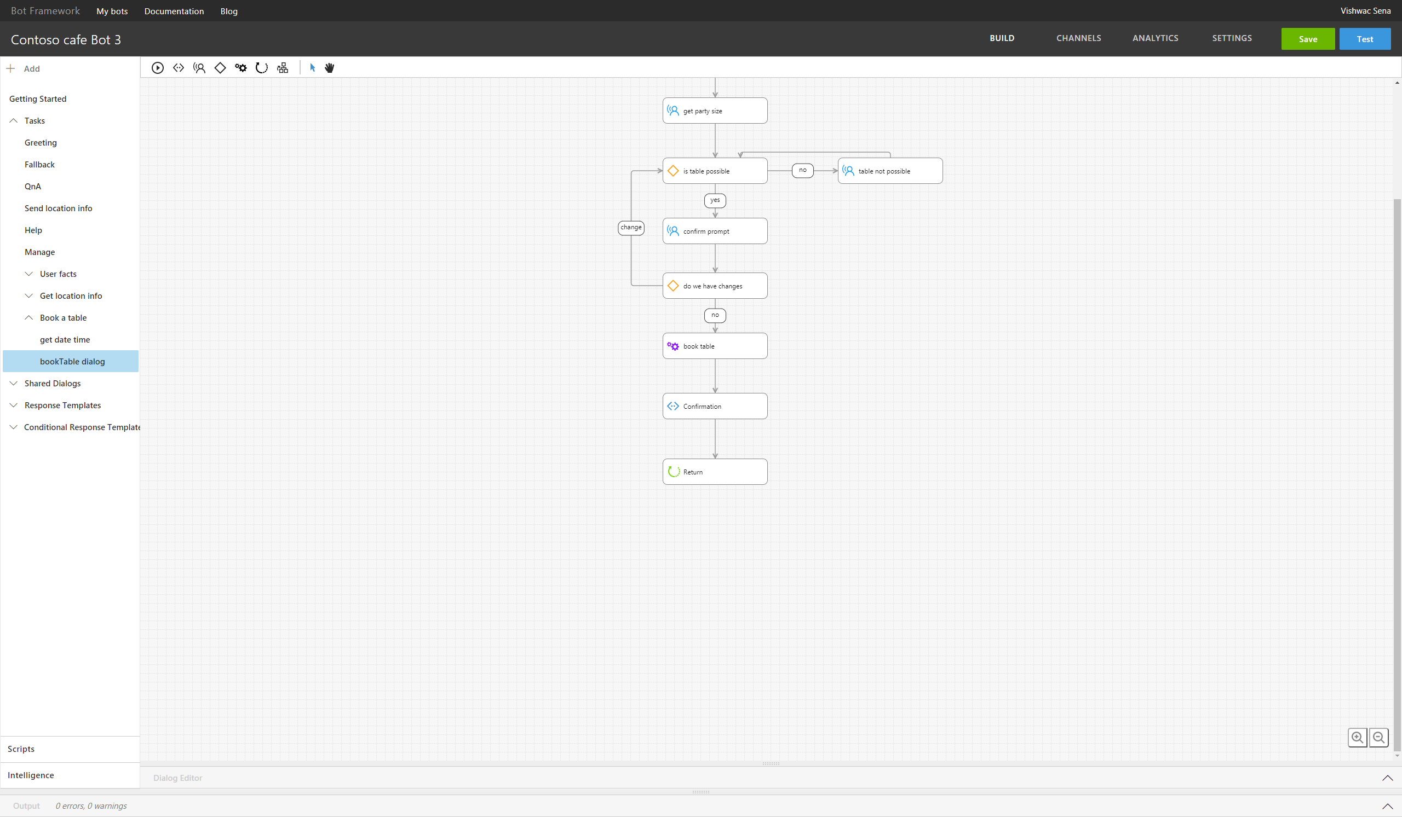

Architecture overview
Conversation Designer
Author/train
LU
LUIS.ai
Author
Bot activity
Bot activity
Bot connector
LU
Save
Developer’s Azure subscription
Website with bot assets + code
Runtime deployed as website extension
LUIS runtime deployed locally
User
Bot app authored using
Conversation Designer
Bot.agent
Bot.js
Cards.json

Slide 24
Demo
Conversation Designer

Slide 25
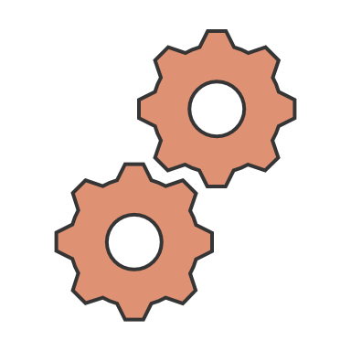

How do the pieces fit together
Authoring
Bot hosting
Start with Conversation Designer to prototype, design your conversations
Implement business logic in Conversation Designer for E2E bot development
Azure
LU
SDK
Implement the conversational model using Azure Bot Service (Bot Builder SDK)
LU
LUIS.ai
Implement the conversational model using Bot Builder SDK
Custom cloud

Slide 26
Summary and call to action
Conversational experiences are everywhere –
  Custom app/ website, custom devices & 1st and 3rd party channels
Incorporate Microsoft cognitive service APIs for your next bot
Design & build for Type, Tap, Talk
Adapt conversations based on context –
  Tailor experiences based on device capabilities
  Follow & deeply understand the user so conversations are natural and effective
Model your conversational flows effectively
  single turn, contextual carry over .vs. structured flow
Pick the right tooling + hosting model
  Azure – Bot Builder SDK, Azure Bot Service Code, Conversation Designer
  Custom cloud – Bot Builder SDK
Check out
  http://dev.botframework.com
  https://github.com/Microsoft/BotBuilder
  https://azure.microsoft.com/en-us/services/bot-service/

